Slide 1
Notes
劉沁雅

Slide 2
Outline
Introduction
Mathematical Formulations
2.1 The velocity profile
2.2 Orr-Sommerfeld equation
2.3 Stability analysis
2.3.1 Temporal and spatial stability
2.3.2 Spatial-temporal stability
2.4 Boundary conditions
2.4.1 Kinematic boundary condition
2.4.2 Dynamic boundary condition
2.4.3 Boundary condition at infinity
Numerical Methods
3.1 Chebyshev collocation method
3.2 Domain Decomposition method
3.3 Generalized eigenvalue problem
3.4 Convergence test on numerical methods
3.4.1 Treatment of infinity boundary
3.4.2 Domain Decomposition method
3.4.3 Comparison of GEP solving algorithms
Results and discussions
4.1 Eigenvalue spectrum
4.2 Temporal stability
4.3 Spatial-temporal stability
4.4 Energy distribution
Conclusion

Slide 3
Outline
Introduction
Mathematical Formulations
2.1 The velocity profile
2.2 Orr-Sommerfeld equation
2.3 Stability analysis
2.3.1 Temporal and spatial stability
2.3.2 Spatial-temporal stability
2.4 Boundary conditions
2.4.1 Kinematic boundary condition
2.4.2 Dynamic boundary condition
2.4.3 Boundary condition at infinity
Numerical Methods
3.1 Chebyshev collocation method
3.2 Domain Decomposition method
3.3 Generalized eigenvalue problem
3.4 Convergence test on numerical methods
3.4.1 Treatment of infinity boundary
3.4.2 Domain Decomposition method
3.4.3 Comparison of GEP solving algorithms
Results and discussion
4.1 Eigenvalue spectrum
4.2 Temporal stability
4.3 Spatial-temporal stability
4.4 Energy distribution
Conclusion

Slide 4
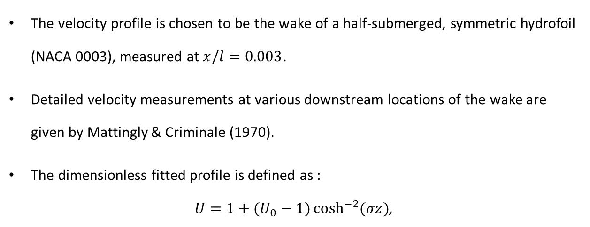
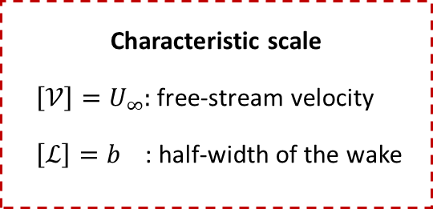
Velocity profile
The velocity profile is chosen to be the wake of a half-submerged, symmetric hydrofoil (NACA 0003), measured at $x/l=0.003$.
Detailed velocity measurements at various downstream locations of the wake are given by Mattingly & Criminale (1970).
The dimensionless fitted profile is defined as :
$U=1+(U_{0}−1)\cosh^{−2}{(σz)}$,
Characteristic scale
$\left[𝒱\right]=U_{∞}$: free-stream velocity
$\left[ℒ\right]=b$ : half-width of the wake

Slide 5
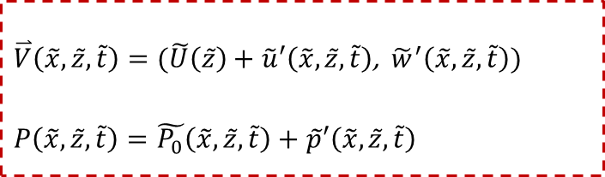
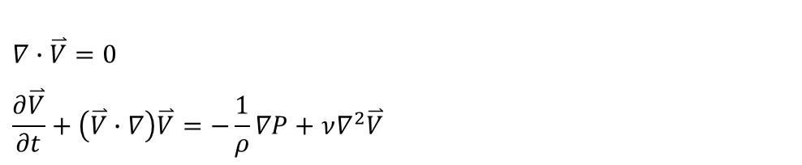
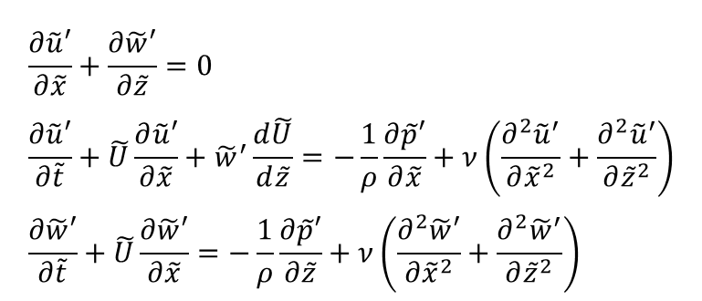
Governing equations
The 2D perturbed flow must satisfy the continuity condition and the Navier-Stokes equation :
The perturbed pressure and velocity are then decomposed into a background state and perturbed flow. After neglecting nonlinear terms, the linearized equations can be written as:
$$∇∙\overset{⃑}{V}=0$$
$$\frac{∂\overset{⃑}{V}}{∂t}+\left(\overset{⃑}{V}∙∇\right)\overset{⃑}{V}=−\frac{1}{ρ}∇P+ν∇^{2}\overset{⃑}{V}$$
$$\frac{∂\tilde{u}′}{∂\tilde{x}}+\frac{∂\tilde{w}′}{∂\tilde{z}}=0 \\ \frac{∂\tilde{u}′}{∂\tilde{t}}+\tilde{U}\frac{∂\tilde{u}′}{∂\tilde{x}}+{\tilde{w}}^{′}\frac{d\tilde{U}}{d\tilde{z}}=−\frac{1}{ρ}\frac{∂\tilde{p}′}{∂\tilde{x}}+ν\left(\frac{∂^{2}{\tilde{u}}^{′}}{∂{\tilde{x}}^{2}}+\frac{∂^{2}{\tilde{u}}^{′}}{∂{\tilde{z}}^{2}}\right) \\ \frac{∂\tilde{w}′}{∂\tilde{t}}+\tilde{U}\frac{∂\tilde{w}′}{∂\tilde{x}}=−\frac{1}{ρ}\frac{∂\tilde{p}′}{∂\tilde{z}}+ν\left(\frac{∂^{2}\tilde{w}′}{∂{\tilde{x}}^{2}}+\frac{∂^{2}{\tilde{w}}^{′}}{∂{\tilde{z}}^{2}}\right)$$
$\overset{⃑}{V}\left(\tilde{x},\tilde{z},\tilde{t}\right)=(\tilde{U}\left(\tilde{z}\right)+\tilde{u}′\left(\tilde{x},\tilde{z},\tilde{t}\right)$,${\tilde{w}}^{′}\left(\tilde{x},\tilde{z},\tilde{t}\right))$ $$P\left(\tilde{x},\tilde{z},\tilde{t}\right)=\tilde{P_{0}}\left(\tilde{x},\tilde{z},\tilde{t}\right)+\tilde{p}′\left(\tilde{x},\tilde{z},\tilde{t}\right)$$

Slide 6
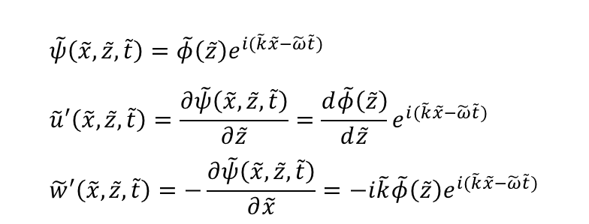
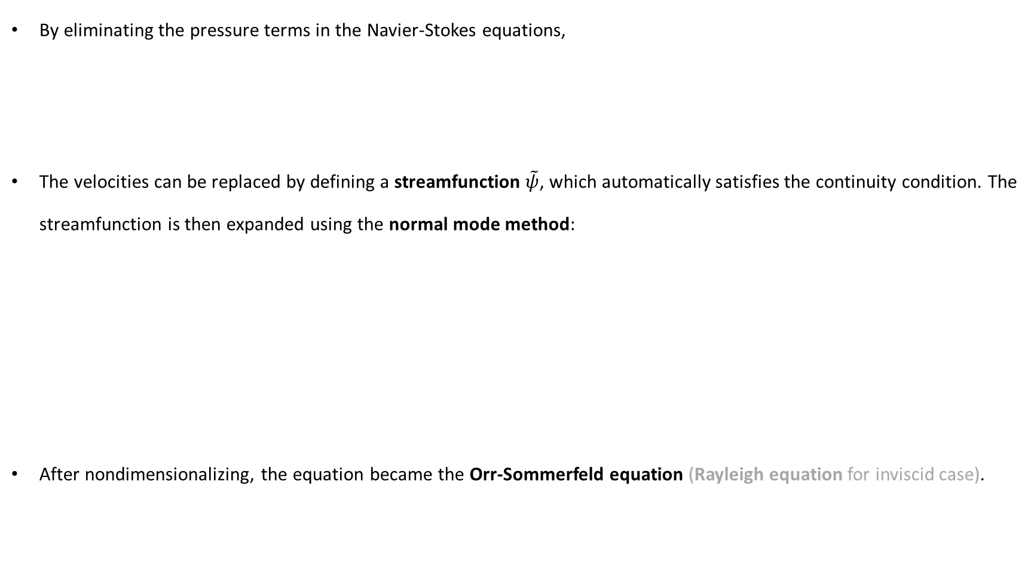
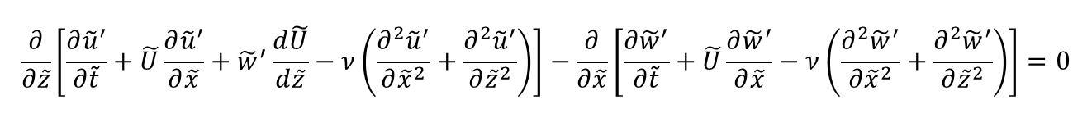
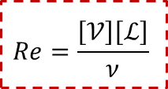
Governing equations
By eliminating the pressure terms in the Navier-Stokes equations,
The velocities can be replaced by defining a streamfunction $\tilde{ψ}$, which automatically satisfies the continuity condition. The streamfunction is then expanded using the normal mode method:
After nondimensionalizing, the equation became the Orr-Sommerfeld equation (Rayleigh equation for inviscid case).
$$\frac{∂}{∂\tilde{z}}\left[\frac{{∂\tilde{u}}^{′}}{∂\tilde{t}}+\tilde{U}\frac{∂{\tilde{u}}^{′}}{∂\tilde{x}}+{\tilde{w}}^{′}\frac{d\tilde{U}}{d\tilde{z}}−ν\left(\frac{{∂^{2}\tilde{u}}^{′}}{∂{\tilde{x}}^{2}}+\frac{{∂^{2}\tilde{u}}^{′}}{∂{\tilde{z}}^{2}}\right)\right]−\frac{∂}{∂\tilde{x}}\left[\frac{{∂\tilde{w}}^{′}}{∂\tilde{t}}+\tilde{U}\frac{{∂\tilde{w}}^{′}}{∂\tilde{x}}−ν\left(\frac{{∂^{2}\tilde{w}}^{′}}{∂{\tilde{x}}^{2}}+\frac{{∂^{2}\tilde{w}}^{′}}{∂{\tilde{z}}^{2}}\right)\right]=0$$
$$\tilde{ψ}\left(\tilde{x},\tilde{z},\tilde{t}\right)=\tilde{φ}\left(\tilde{z}\right)e^{i(\tilde{k}\tilde{x}−\tilde{ω}\tilde{t})} \\ \tilde{u}′\left(\tilde{x},\tilde{z},\tilde{t}\right)=\frac{∂\tilde{ψ}\left(\tilde{x},\tilde{z},\tilde{t}\right)}{∂\tilde{z}}=\frac{d\tilde{φ}\left(\tilde{z}\right)}{d\tilde{z}}e^{i(\tilde{k}\tilde{x}−\tilde{ω}\tilde{t})} \\ \tilde{w}′\left(\tilde{x},\tilde{z},\tilde{t}\right)=−\frac{∂\tilde{ψ}\left(\tilde{x},\tilde{z},\tilde{t}\right)}{∂\tilde{x}}=−i\tilde{k}\tilde{φ}\left(\tilde{z}\right)e^{i(\tilde{k}\tilde{x}−\tilde{ω}\tilde{t})}$$
$$\frac{i}{ Re}\frac{d^{4}φ}{dz^{4}}+\left(kU−\frac{2ik^{2}}{Re}\right)\frac{d^{2}φ}{dz^{2}}+\left(\frac{ik^{4}}{Re}−k^{3}U−k\frac{d^{2}U}{dz^{2}}\right)φ=ω\left(\frac{d^{2}φ}{dz^{2}}−k^{2}φ\right)$$
$$Re=\frac{\left[𝒱\right]\left[ℒ\right]}{ν}$$

Slide 7
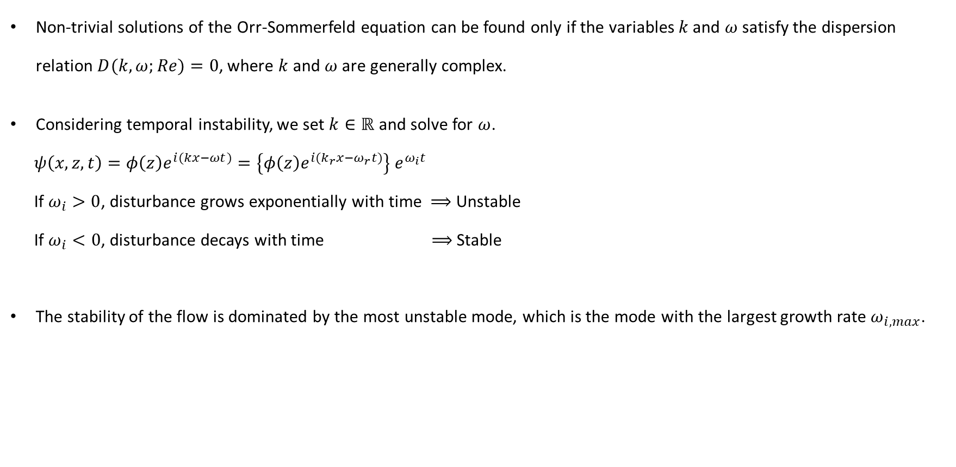
Temporal stability analysis
Non-trivial solutions of the Orr-Sommerfeld equation can be found only if the variables $k$ and $ω$ satisfy the dispersion relation $D(k,ω;Re)=0$, where $k$ and $ω$ are generally complex.
Considering temporal instability, we set $k∈ℝ$ and solve for $ω$.
$ψ\left(x,z,t\right)=φ\left(z\right)e^{i(kx−ωt)}=\left\{φ\left(z\right)e^{i(k_{r}x−ω_{r}t)}\right\} e^{ω_{i}t}$
If $ω_{i}>0$, disturbance grows exponentially with time ⟹ Unstable
If $ω_{i}<0$, disturbance decays with time ⟹ Stable
The stability of the flow is dominated by the most unstable mode, which is the mode with the largest growth rate $ω_{i,max}$.

Slide 8
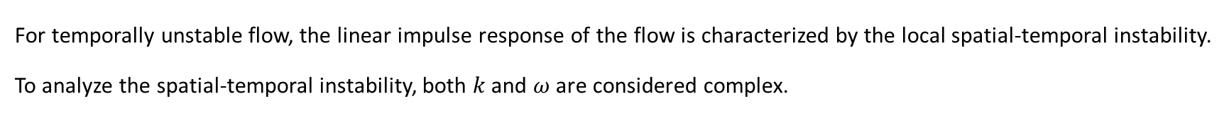
Spatial-temporal instability
For temporally unstable flow, the linear impulse response of the flow is characterized by the local spatial-temporal instability. To analyze the spatial-temporal instability, both $k$ and $ω$ are considered complex.
Absolute instability
The disturbance grows both upstream and downstream, which gradually affect the whole flow field.
Convective instability
The disturbances convects away from its initial location, leaving the initial location undisturbed.
Reference : Plasma Physics and Fusion Plasma Electrodynamics. Abraham Bers.

Slide 9
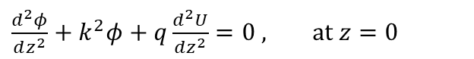
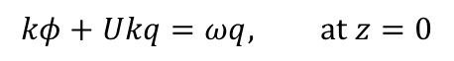
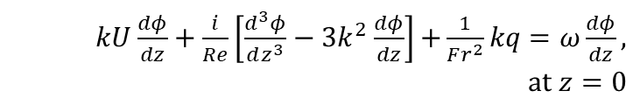
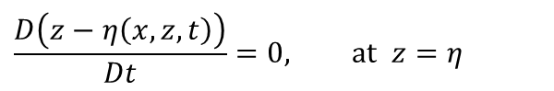
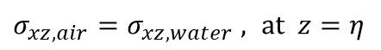
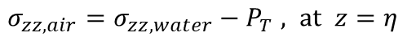
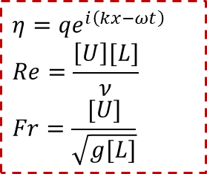
Boundary conditions at free surface
$η={qe}^{i\left(kx−ωt\right)}$
$$Re=\frac{\left[U\right][L]}{ν}$$
$$Fr=\frac{[U]}{\sqrt{g[L]}}$$
Kinematic boundary condition:
$$\frac{D\left(z−η\left(x,z,t\right)\right)}{Dt}=0, at z=η$$
$$kφ+Ukq=ωq, at z=0$$
By linearization, nondimensionalize and normal mode expansion.
Dynamic boundary condition:
Tangential direction
Normal direction
$\frac{d^{2}φ}{dz^{2}}+k^{2}φ+q\frac{d^{2}U}{dz^{2}}=0$ $, at z=0$
$σ_{xz,air}=σ_{xz,water}$ $, at z=η$
$kU\frac{dφ}{dz}+\frac{i}{Re}\left[\frac{d^{3}φ}{dz^{3}}−3k^{2}\frac{dφ}{dz}\right]$ $+\frac{1}{Fr^{2}}kq$ $=ω\frac{dφ}{dz}, at z=0$
$σ_{zz,air}=σ_{zz,water}−P_{T}$ $, at z=η$
Assume base flow pressure balanced, and by linearization, nondimensionalize and normal mode expansion.

Slide 10
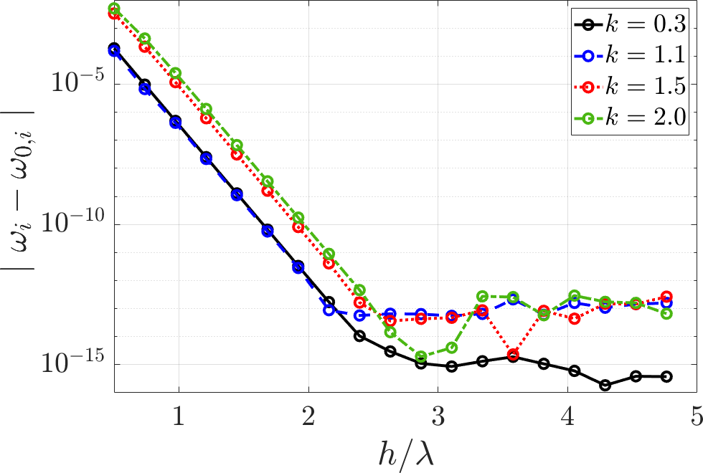
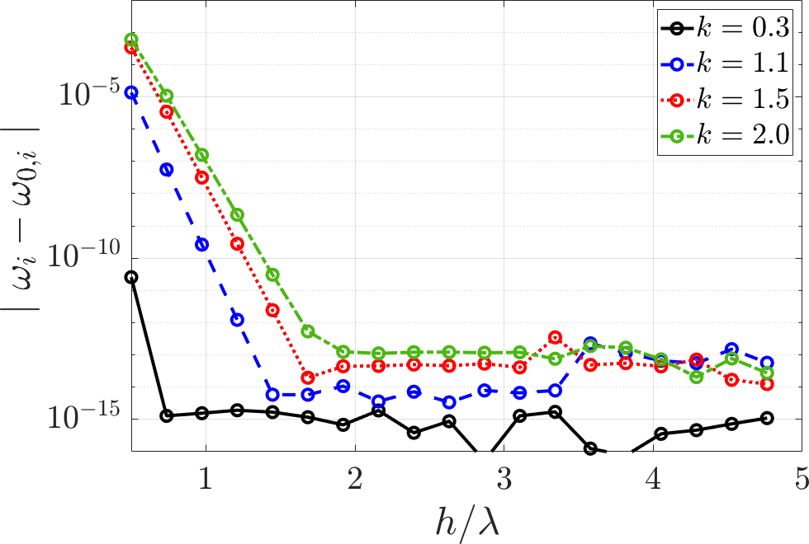
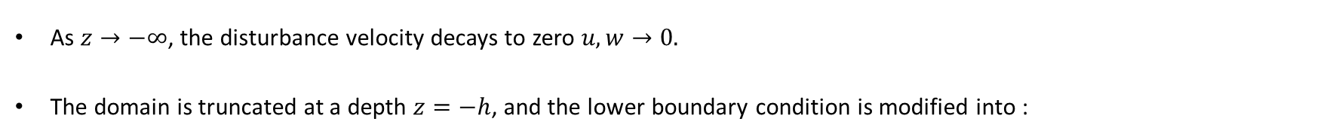
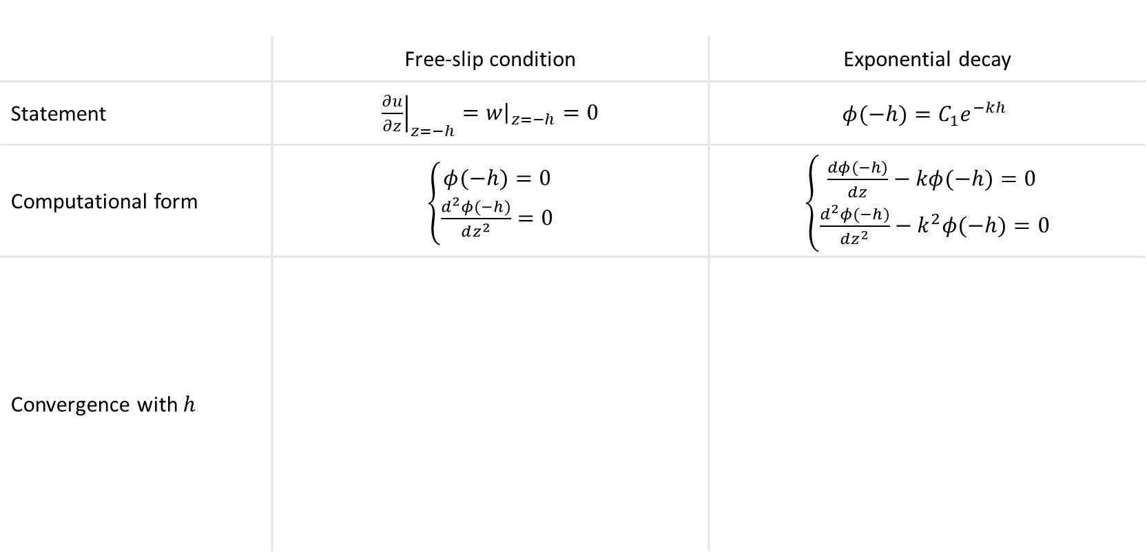
Boundary conditions at truncation height
As $z→−∞$, the disturbance velocity decays to zero $u,w→0.$
The domain is truncated at a depth $z=−h$, and the lower boundary condition is modified into :
 | Free-slip condition | Exponential decay
Statement | ${\left.\frac{∂u}{∂z}\right|}_{z=−h}={\left.w\right|}_{z=−h}=0$ | $$φ(−h)=C_{1}e^{−kh}$$
Computational form | $\left\{\begin{aligned}φ(−h)=0 \\ \frac{d^{2}φ(−h)}{dz^{2}}=0\end{aligned}\right.$ | $\left\{\begin{aligned}\frac{dφ(−h)}{dz}−kφ(−h)=0 \\ \frac{d^{2}φ(−h)}{dz^{2}}−k^{2}φ(−h)=0\end{aligned}\right.$
Convergence with $h$

Slide 11
Outline
Introduction
Mathematical Formulations
2.1 The velocity profile
2.2 Orr-Sommerfeld equation
2.3 Stability analysis
2.3.1 Temporal and spatial stability
2.3.2 Spatial-temporal stability
2.4 Boundary conditions
2.4.1 Kinematic boundary condition
2.4.2 Dynamic boundary condition
2.4.3 Boundary condition at infinity
Numerical Methods
3.1 Chebyshev collocation method
3.2 Domain Decomposition method
3.3 Generalized eigenvalue problem
3.4 Convergence test on numerical methods
3.4.1 Treatment of infinity boundary
3.4.2 Domain Decomposition method
3.4.3 Comparison of GEP solving algorithms
Results and discussion
4.1 Eigenvalue spectrum
4.2 Temporal stability
4.3 Spatial-temporal stability
4.4 Energy distribution
Conclusion

Slide 12
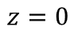
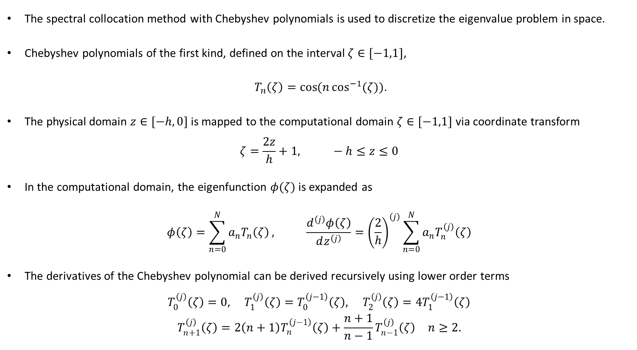
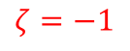
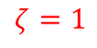
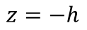
Chebyshev collocation method
The spectral collocation method with Chebyshev polynomials is used to discretize the eigenvalue problem in space.
Chebyshev polynomials of the first kind, defined on the interval $ζ∈[−1,1]$,
$T_{n}\left(ζ\right)=\cos{(n\cos^{−1}{(ζ)})}$.
The physical domain $z∈[−h,0]$ is mapped to the computational domain $ζ∈[−1,1]$ via coordinate transform
$$ζ=\frac{2z}{h}+1, −h≤z≤0$$
In the computational domain, the eigenfunction $φ(ζ)$ is expanded as
$$φ\left(ζ\right)=\sum_{n=0}^{N}{a_{n}T_{n}\left(ζ\right)}, \frac{d^{\left(j\right)}φ\left(ζ\right)}{dz^{\left(j\right)}}={\left(\frac{2}{h}\right)}^{\left(j\right)}\sum_{n=0}^{N}{a_{n}T_{n}^{\left(j\right)}\left(ζ\right)}$$
The derivatives of the Chebyshev polynomial can be derived recursively using lower order terms
$$T_{0}^{\left(j\right)}\left(ζ\right)=0, T_{1}^{\left(j\right)}\left(ζ\right)=T_{0}^{\left(j−1\right)}\left(ζ\right), T_{2}^{\left(j\right)}\left(ζ\right)=4T_{1}^{\left(j−1\right)}\left(ζ\right)$$
$$T_{n+1}^{\left(j\right)}\left(ζ\right)=2\left(n+1\right)T_{n}^{\left(j−1\right)}\left(ζ\right)+\frac{n+1}{n−1}T_{n−1}^{\left(j\right)}\left(ζ\right) n≥2.$$
$$z=0$$
$$ζ=1$$
$$z=−h$$
$$ζ=−1$$

Slide 13
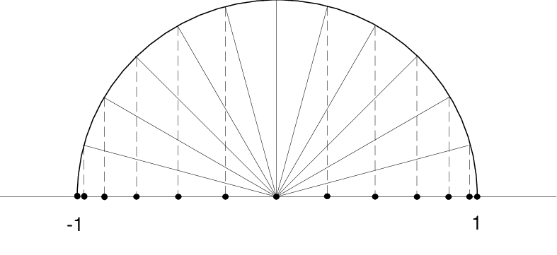
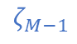
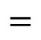
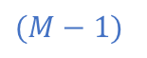

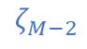
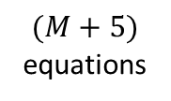
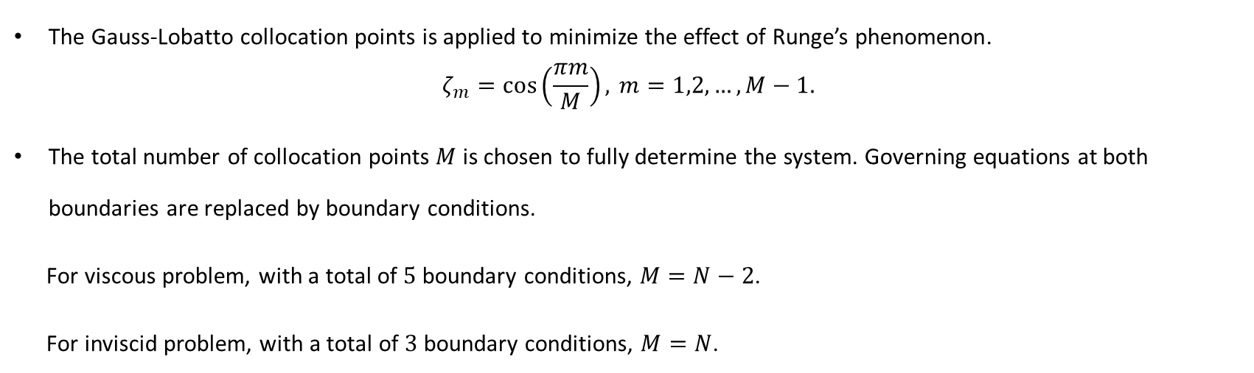

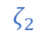
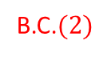
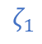
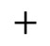
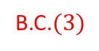
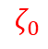
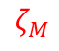
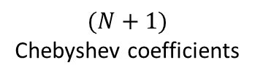
Chebyshev collocation method
The Gauss-Lobatto collocation points is applied to minimize the effect of Runge’s phenomenon.
$$ζ_{m}=\cos\left(\frac{πm}{M}\right), m=1,2,…,M−1.$$
The total number of collocation points $M$ is chosen to fully determine the system. Governing equations at both boundaries are replaced by boundary conditions.
For viscous problem, with a total of $5$ boundary conditions, $M=N−2$.
For inviscid problem, with a total of $3$ boundary conditions, $M=N$.
$$ζ_{0}$$
B.C.$(3)$
$$ζ_{1}$$
$$ζ_{2}$$
$$⋮$$
$(M−1)$
$(M+5)$ equations
$$=$$
$(N+1)$
Chebyshev coefficients
$$+$$
$$1$$
surface elevation
$$ζ_{M−2}$$
$$ζ_{M−1}$$
$$ζ_{M}$$
B.C.$(2)$

Slide 14
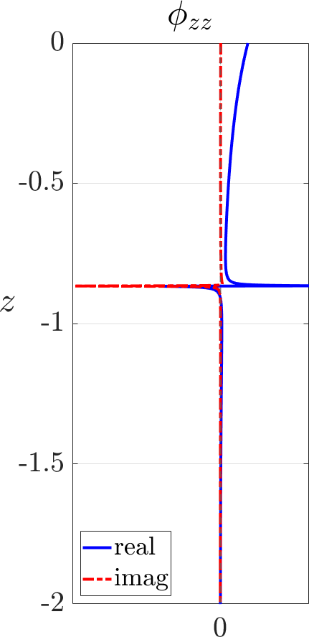
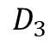
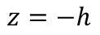
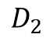
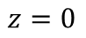
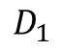
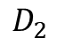
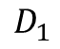

Domain decomposition method
For cases with rapid changes of flow properties occurring far from the boundaries, the collocation points around these locations may be insufficient to resolve the eigenfunctions.
The domain decomposition method is done by splitting the computational domain at locations with abrupt changes of the eigenfunction, while applying Gauss-Lobatto points within each domain.
2 domains
4 domains
$$z=0$$
$$D_{1}$$
$$D_{1}$$
$$D_{2}$$
Abrupt change of eigenfunction
$$D_{3}$$
$$D_{2}$$
$$D_{4}$$
$$z=−h$$
Matching conditions are satisfied at the splitting points, with continuity of the eigenfunction up to the third order for viscous problems and up to the first order for inviscid problems. $\frac{d^{n}φ_{\left(k\right),−}}{dz^{n}}=\frac{d^{n}φ_{\left(k+1\right),+}}{dz^{n}}$

Slide 15





Domain decomposition method ─ critical point
For the inviscid assumption, the Rayleigh equation has a regular singular point at a point $z_{0}$ with $U\left(z_{0}\right)=c$. The critical point $z_{c}$ is the point where $U\left(z_{c}\right)=c_{r}$, and as $z_{0}$ approaches the real axis, the eigenfunction varies more abruptly at $z_{c}$.
Splitting the computational domain requires the location of $z_{c}$, and while it is an unknown value, its location is guessed initially and solved by iteration.
Initial value of $z_{c}$
Domain decomposition
Calculate $z_{c}$
Solve for eigenvalue
The initial split location affects the converging speed of the iteration. For extreme cases, an inaccurate initial split location may result in failing to solve for an eigenvalue. Therefore the initial split location is chosen by critical points of solvable cases with similar parameters.
$ω$ converges
No
Yes
Return $ω$

Slide 16





Generalized eigenvalue system
With the Chebyshev collocation method, the system is rearranged into a generalized eigenvalue system (GEP).
$$\left[\begin{matrix} & & \\ & A & \\ & & \end{matrix}\right]\left(\begin{aligned}a_{0} \\ a_{1} \\ ⋮ \\ a_{N} \\ q\end{aligned}\right)=ω\left[\begin{matrix} & & \\ & B & \\ & & \end{matrix}\right]\left(\begin{aligned}a_{0} \\ a_{1} \\ ⋮ \\ a_{N} \\ q\end{aligned}\right)$$
QZ algorithm
Inverse $A$ or $B$
Standard algorithm of Matlab’s GEP solver.
No inversions are used, so can be applied to systems with singular matrices.
Reduces GEPs into standard eigenvalue problems.
Inverses either matrix $A$ or $B$, the matrices must be invertible, if not matrices must be de-singularized.
De-singularize : With our boundary conditions and matching conditions, matrix $B$ is singular.
$\left[\begin{aligned}A_{0} \\ A_{1} \\ ⋮ \\ A_{N+1}\end{aligned}\right]x=ω\left[\begin{aligned}0 \\ B_{1} \\ ⋮ \\ B_{N+1}\end{aligned}\right]x$ $\left[\begin{aligned}A_{0} \\ A_{1} \\ ⋮ \\ A_{N+1}\end{aligned}\right]x=ω\left[\begin{aligned}εA_{0} \\ B_{1} \\ ⋮ \\ B_{N+1}\end{aligned}\right]x$
$ε:$ A complex multiple

Slide 17


Convergence test for numerical method
Conversion tests are done by examining the convergence of growth rate with number of collocation points needed.
With no available analytical solution, the error is computed by comparing with the assumed most accurate solution, which is the case with the most collocation points.
Method are chosen according to both convergence and computational time.
Test case
$$Fr$$ | $$1.5$$
$$Re$$ | $1000$ (viscous) | $∞$ (inviscid)
$$k$$ | $$0.3, 1.1, 1.5, 2$$ | $$0.3, 1.1, 1.5, 3$$
Bottom B.C. | Exponential decay
$$h$$ | $$3λ$$
Number of domains | $$4$$
GEP solver | Inverse A
Balancing | Yes
De-singularize | Yes

Slide 18


Convergence test for numerical method ─ Truncation height
$2$ methods : Free slip condition, Exponential decay.
 | Free slip condition | Exponential decay
Inviscid
Viscous

Slide 19
















Convergence test for numerical method ─ DDM
$3$ methods : Splitting into $2$ domains, $4$ domains, or without DDM.
$$k=0.3$$
$$k=1.1$$
$$k=1.5$$
$$k=3$$
Inviscid
For inviscid problems, splitting into $4$ domains leads to the best convergence, converging at around $N=600$.
$$k=0.3$$
$$k=1.1$$
$$k=1.5$$
$$k=2$$
Viscous
For viscous problems, DDM doesn’t improve the overall convergence, for simplicity choose $N=600$ as in inviscid problems.

Slide 20








Convergence test for numerical method ─ GEP solver (inviscid)
$3$ methods : QZ, inverse matrix A, inverse matrix B.
 | $$k=0.3$$ | $$k=1.1$$ | $$k=1.5$$ | $$k=3$$
Error
Time
Inversing matrix $A$ or $B$ has better convergence and lower computational time at high grid numbers than QZ.

Slide 21









Convergence test for numerical method ─ GEP solver (inviscid)
Test for balancing and de-singularizing.
 | $$k=1.1$$ |  | $$k=3$$
 | No De-singularizing | De-singularizing | No De-singularizing | De-singularizing
No Balancing
Balancing
De-singularizing has little effect while doing balancing improves the convergence for around one order.
While de-singularizing isn’t necessary, we choose to use inverse $A$.

Slide 22









Convergence test for numerical method ─ GEP solver ($Re=1000$)
$3$ methods : QZ, inverse matrix A, inverse matrix B.
 | $$k=0.3$$ | $$k=1.1$$ | $$k=1.5$$ | $$k=2$$
Error
Time
Inversing matrix $A$ has better convergence than the other two methods.

Slide 23









Convergence test for numerical method ─ GEP solver ($Re=1000$)
Test for balancing and de-singularizing.
 | $$k=1.1$$ |  | $$k=1.5$$
 | No De-singularizing | De-singularizing | No De-singularizing | De-singularizing
No Balancing
Balancing
De-singularizing has little effect while doing balancing slightly improves the convergence for inversing $A$

Slide 24






Conversion test for numerical method ─ final choice
After applying the solvers chosen in the previous sections, the convergence test is done once more to get the number of collocation points required.
Inviscid solver requires $500$ collocation points to converge, while viscous solver at $Re=1000$ requires $300$ collocation points to converge.
$$Re=∞$$
 | Inviscid | Viscous
Bottom B.C. | Exponential decay | Exponential decay
$$h$$ | $$3λ$$ | $$3λ$$
Number of domains | 4 | $$1$$
GEP solver | Inverse A | Inverse A
Balancing | Yes | Yes
De-singularize | No | No
$$N$$ | 600 | 400
$$Re=1000$$

Slide 25





Convergence test with a different profile
Nondimensional cylinder wake profile at $x ̃/d=1$ : $U\left(z\right)=1−0.75(1−tanh⁡(4z^{2}−0.32))$
Characteristic scale
$\left[𝒱\right]=U_{∞}$: free-stream velocity
$\left[ℒ\right]=d :$ cylinder diameter
Test case
$$Fr$$ | $$1.5$$
$$Re$$ | $1000$ (viscous) | $∞$ (inviscid)
$$k$$ | $0.3, 1.1, 1.5, 4$.5 | $$0.3, 1.1, 1.5, 3$$
Bottom B.C. | Exponential decay
$$h$$ | $$3λ$$
Number of domains | $$4$$
GEP solver | Inverse A
Balancing | Yes
De-singularize | Yes

Slide 26





Convergence test for numerical method ─ Truncation height
$2$ methods : Free slip condition, Exponential decay.
 | Free slip condition | Exponential decay
Inviscid
Viscous

Slide 27






Convergence test for numerical method ─ DDM
$3$ methods : Splitting into $2$ domains, $4$ domains, or without DDM.
Original
2 domains
4 domains
Inviscid
Viscous

Slide 28









Convergence test for numerical method ─ GEP solver ($Re=inf$)
$3$ methods : QZ, inverse matrix A, inverse matrix B.
 | $$k=0.3$$ | $$k=1.1$$ | $$k=1.5$$ | $$k=3$$
Error
Time
Inversing matrix $A$ has better convergence than the other two methods.

Slide 29









Convergence test for numerical method ─ GEP solver ($Re=1000$)
$3$ methods : QZ, inverse matrix A, inverse matrix B.
 | $$k=0.3$$ | $$k=1.1$$ | $$k=1.5$$ | $$k=4.5$$
Error
Time
Inversing matrix $A$ has better convergence than the other two methods.

Slide 30








Convergence test for numerical method - balancing and de-singularize
The tests are only done using algorithm inv(A), due to its better convergence compared to the other two algorithms.
 | $$k=1.5$$ |  | $$k=4.5$$
 | De-singularizing | Balancing | De-singularizing | Balancing
Inviscid
Viscous
Results shows that both balancing and de-singularizing are unnecessary.

Slide 31






Conversion test for numerical method ─ final choice
$$Re=∞$$
$$Re=1000$$
Its properties are similar to using hydrofoil wake profiles, while converging at a smaller truncation height.
Cylinder wake
Hydrofoil wake
 | Inviscid | Viscous
Bottom B.C. | Exponential decay | Exponential decay
$$h$$ | $$1.5λ$$ | $$2λ$$
Number of domains | 4 | $$1$$
GEP solver | Inverse A | Inverse A
Balancing | No | No
De-singularize | No | No
$$N$$ | 600 | 400
 | Inviscid | Viscous
Bottom B.C. | Exponential decay | Exponential decay
$$h$$ | $$3λ$$ | $$3λ$$
Number of domains | 4 | $$1$$
GEP solver | Inverse A | Inverse A
Balancing | Yes | Yes
De-singularize | No | No
$$N$$ | 600 | 400

Slide 32











Morland(1991) shear layer instability
Characteristic scale
$$\left[𝒱\right]=c_{m}={\left(4\tilde{g}\tilde{T}\right)}^{1/4}$$
$$\left[ℒ\right]=λ_{m}=2π\sqrt{\tilde{T}/\tilde{g}}$$
Dimensionless velocity profile
Exponential | $$U\left(z\right)=u_{d}\exp\left(\frac{2z}{Δ}\right),$$
Error function | $$U\left(z\right)=u_{d}\text{erfc}\left(−\frac{2z}{Δ\sqrt{π}}\right),$$
Integrated error function | $$U\left(z\right)=u_{d}\left[\text{exp}\left(−\frac{πz^{2}}{4Δ^{2}}\right)\text{+}\frac{πz}{2Δ}\text{erfc}\left(−\frac{\sqrt{π}z}{2Δ}\right)\right],$$
$u_{d}$ : fluid surface velocity
$Δ=\frac{2}{u_{d}}\int_{−∞}^{0}{U\left(z\right)dz}$
$$u_{d}=2$$
$$u_{d}=2$$
$$0.817$$
$$0.291$$
$$0.291$$

Slide 33












Comparison between algorithms
$N=1500,$ inv$(A)$
Using inverse $A$, neither boundary condition treatments converges with increasing truncation height.
$$A$$
$$B$$
$U\left(\frac{d^{2}φ}{dz^{2}}−k^{2}φ\right)−\frac{d^{2}U}{dz^{2}}φ=c\left(\frac{d^{2}φ}{dz^{2}}−k^{2}φ\right)$
$$→0$$
$$→0$$
Truncation height (with exponential decay)
$h=5λ$
Rayleigh equation $u_{d}=2$ $Δ=0.291$ $λ=0.817$

